Slide 1
First, Introduce Yourself.
“Hi, I’m ____. Tell me a little more about your home here.”
Start walking through the home with them.

Slide 2
Now, ask them…
“Why did you buy this home in the first place?”
Wait for them to tell you…

Slide 3
Then, ask them this:
“What were the things that caused you to make an offer and then buy it?”
Wait for them to tell you…

Slide 4
Now, REALLY show some interest in the home…
“Have you done any upgrades or improvements to the house?”
Now… Move to the kitchen table

Slide 5
Ask them for a glass of water
“Hey would you mind if I asked for a glass of water?”
Let them get one for you…

Slide 6
Once you have the water, say this:
“I have a couple questions and also want to review what’s going on in the real estate market with you. Can we do it at the table?
Sit down at the table with them…

Slide 7
Before you start the listing presentation, say this…
“I’m not trying to list your home. I’m want to help you get it sold.” I do work with lots of buyers on an ongoing basis”
Now, ask some questions…

Slide 8
First, ask this…
“What is causing you to want to sell your home?”
Let them answer…

Slide 9
Then, ask this…
“What do you think is happening in the real estate market?”
Let them answer…

Slide 10
Now Say…
“Let me review with you, very quickly, what’s currently happening in our market”
Flip to the next slide and then show them the screen.

Slide 11
Homes ARE Selling: Here’s A Home I Sold Recently
The homeowner was motivated…
Didn’t want to take chances with pricing like everyone else…
Market Value was around
The home was listed at market value.
Received (an offer) within
SOLD for

Slide 12
What about OTHER Local Homes?
Total Homes on the Market:______
Total # of Sales in 2014: ______
# of Home Sales in past 90 Days: ____
# of Homes Pending in last 30 Days: ____
List Price VS. Sales Price in 2013: ____
Average Days on Market in 2013: ____

Slide 13
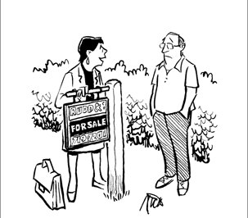
But here’s the sad truth…
Only 4.9% of the homes on the market sell each month. (National average)
“Our signs are guaranteed for five years.”

Slide 14
What will it take to be one of the 4.9 % ?

Slide 15
More Bad News…
70% Of All Homes Listed Don’t Sell In The Entire 6 Months On The Market.
Don’t Pull your Hair out!!

Slide 16
Can you imagine being on the market for 6 months and not even selling?

Slide 17
What Do You Need To Do To Get Your Home Sold?
More Exposure = More Showings

Slide 18
Any Realtor You Hire Can Get You More Exposure
ANY Realtor Can…
List Your Home On The Multiple Listing Service (MLS) .
Advertise your home on Realtor.com
Put a sign in the front yard

Slide 19
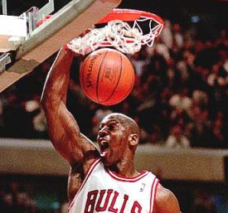
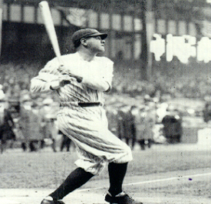
But It’s NOT The TOOLS That Make The Difference
If you had Tiger Woods’ golf clubs, could you play as well as he does?
If you had the same basketball that Michael Jordan used in the NBA, could you shoot baskets like he did?
If you used the same baseball bat as Babe Ruth, could you hit the ball out of the park like he did?

Slide 20
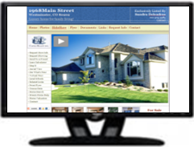
Here’s How I’ll Be Advertising Your Home…
Advertise Your Home On Top Real Estate Sites
Call Residents Around Your Home To Bring Family & Friends
My Buyer’s List
Market Your Home To Other Realtors To Bring Their Buyers!
Local Info Line

Slide 21
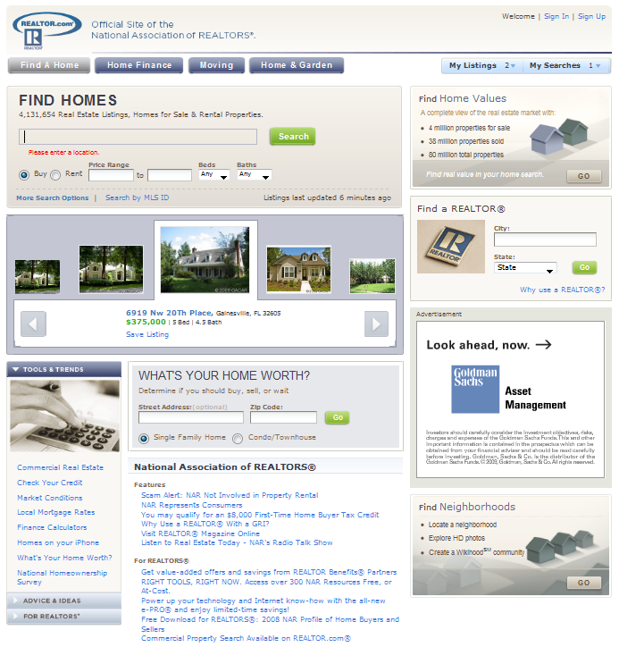
Advertise On Realtor.com
Realtor.com is the #1 Searched Website For Home Buyers…
Over 5 Million Visitors Per Month…
Photos of Your Listing…
Neighborhood and School Information…
Comments To Position Your Home As A “Deal” to Buyers…
And lots more…

Slide 22
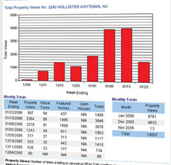
You’ll Even Get a SHOWCASE Listing
Triple The Amount of Traffic As The Normal Realtor.com Listing gets…
Up to 25 MORE Photos…
Realtor.com Virtual And Video Tours…
Custom Headline and Description…
Traffic Reports For Your Listing…

Slide 23
You Will Be In The MLS
List Your Home On The Multiple Listing Service (MLS)
Post Special Comments That Will Pull Your Listing When Other Realtors Are Searching For Deals On The MLS.
Examples of Comments: “This Is Not Foreclosure, Short Sale, Bank Owned Home, REO, HUD Sale, Auction, Etc.”

Slide 24
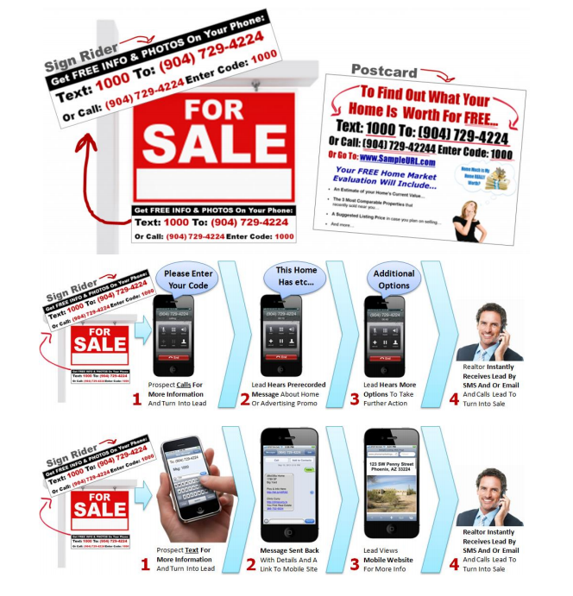
24 Hour Automatic Hotline
Your Own Pre-Recorded local info line With Details About Your Home…
It Normally Gets 3 Times The Number Of Calls As A Sales Office Gets…

Slide 25
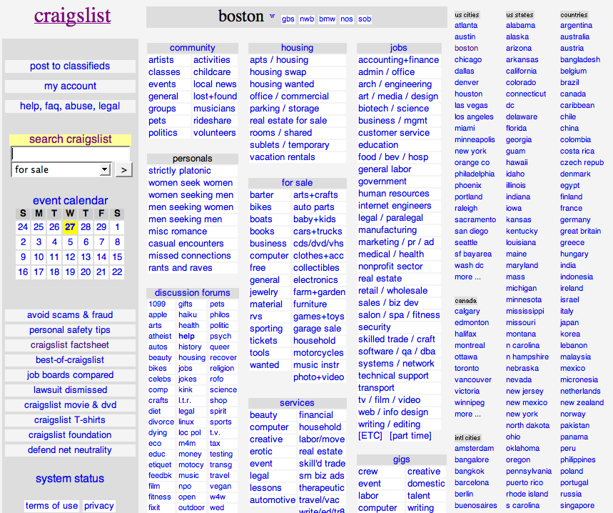
Craigslist.org
9th Most Visited Site In USA…
Compelling Ads Posted On CraigsList.org Regularly…
Captures All Interested Buyers So I Can Follow Up With Them…

Slide 26
Send Notifications To Buyers And Realtors In Our Area
The Buyers who are looking for a home in your area…
The Realtors Who Work With Buyers In Your Area…

Slide 27
My Proactive Approach
I’ll Give You Feedback When Your Home Is Shown…
Contact You Weekly With Results
Send You Information On Homes Similar To Yours That Are…
Listed…
Go Under Contract…
Or Sell…

Slide 28
I’ll Do Whatever I Can To Get YOU The Most Money Possible
I’ll Do everything I can to get Multiple Buyers Into A Bidding War…
Work Buyer Offers Up As High As I Feel Possible Without Scaring Them Off…
I’ll Look Out For YOU And YOUR Best Interest When Negotiating With Buyers…

Slide 29
But This ONLY Works If We Are A Team…
We have to trust each other
I am NOT pushing you to drop your price just to get a quick sale
I work for YOU… Nobody else
We have to have the same goals:
A Fair Price
A Real Buyer
A Quicker Sale

Slide 30
Regularly 8% commission
Now Your Low Investment Is…
Only 3% Listing Commission
I am going ask you to make a decision TODAY, because I know this only works for serious home sellers…

Slide 31
Best Contact Methods?
What e-mail address would you like me to send updates to?
What’s the best phone number to call you with updates?

